Slide 1
Styling React Components
From Inline Styles to CSS Modules

Slide 2
How Do We Style React Components?
React itself does not provide CSS.
Its responsibility is to describe what the UI should look like, not how styles are written.
Instead, React integrates naturally with CSS.
Notes:
“React was created by Meta in 2013 and is an open-source JavaScript library for building user interfaces. It is especially popular for single-page applications, where the UI changes without full page reloads.”
“React is widely used because it helps teams build interfaces that are easier to scale and maintain.” Notes

Slide 3
React Philosophy
UI is described using components.
CSS controls presentation.
Choose a styling approach that improves maintainability.
Prevent style leakage between components.

Slide 4
Three Common Approaches
Inline Styles
External CSS
CSS Modules

Slide 5
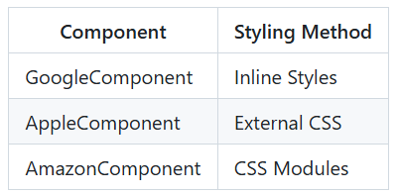
Our Case Study – Three Components
<App>
├── GoogleComponent
├── AppleComponent
└── AmazonComponent

Slide 6
App.jsx
import GoogleComponent from "./components/GoogleComponent";
import AppleComponent from "./components/AppleComponent";
import AmazonComponent from "./components/AmazonComponent";
export default function App() {
return (
<div>
<GoogleComponent />
<AppleComponent />
<AmazonComponent />
</div>
);
}

Slide 7
JSX Is JavaScript
React doesn't use HTML directly.
Instead, JSX compiles into JavaScript.
style becomes a JavaScript object
In JSX, CSS properties use camelCase
JSX
HTML
<div
className="card"
style={{ color: "red" }}
>
<div class="card" style="color:red">

Slide 8
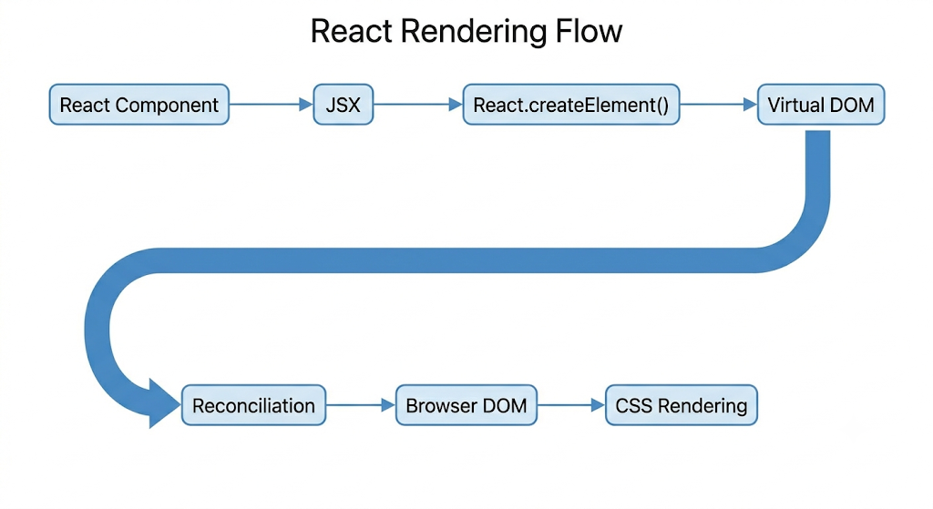
Rendering Pipeline

Slide 9
Method 1: Inline Styles
export default function GoogleComponent() {
const styles = {
border: "2px solid #4285F4",
padding: "20px",
borderRadius: "8px",
backgroundColor: "#f9f9f9",
fontFamily: "Arial"
};
return (
<div style={styles}>
<h2>Google</h2>
<p>Search Engine</p>
</div>
);
}

Slide 10
Inline Styles - Advantages
Advantages
Easy to generate dynamically
Uses props easily
Perfect for runtime styling
const buttonStyle = {
backgroundColor:
isDark ? "black" : "white"
};
<div style={{
color: props.color
}}>

Slide 11
Inline Styles - Limitations
Limitations
No hover
No media queries
Can clutter component logic
:hover
@media(...)

Slide 12
Method 2: External (Traditional) CSS
import "./AppleComponent.css";
export default function AppleComponent() {
return (
<div className="card">
<h2>Apple</h2>
<p>Technology Company</p>
</div>
);
}
.card {
border: 2px solid black;
padding: 20px;
border-radius: 8px;
background: white;
}

Slide 13
External CSS - Advantages
.card:hover{
background:#eee;
}
Advantages
Familiar Syntax
Works with every CSS feature
@media(max-width:768px){
.card{
width:100%;
}
}

Slide 14
External CSS - Limitations
Global namespace.
.card may exist in
AppleComponent.css and GoogleComponent.css
Result:Unexpected style overrides.

Slide 15
The Global CSS Problem
.card{
background:red;
}
Suppose two developers write .card
Which wins?
The answer depends on
  import order
  CSS specificity
  cascade rules
Large applications become difficult to maintain.
.card{
background:blue;
}

Slide 16
Method 3: CSS Modules
import styles from "./AmazonComponent.module.css";
export default function AmazonComponent() {
return (
<div className={styles.card}>
<h2>Amazon</h2>
<p>E-Commerce Platform</p>
</div>
);
}
.card{
border:2px solid orange;
padding:20px;
border-radius:8px;
}

Slide 17
What Happens During Build?
You write .card
Webpack/Vite transforms it into .card__3xa91
Your JSX styles.card becomes <div class="card__3xa91">
Every component receives its own unique class names.
No collisions.

Slide 18
CSS Modules Benefits
Component encapsulation
No naming conflicts
Supports
  hover
  animations
  media queries
  keyframes
Example
.card:hover{
transform:scale(1.05);
}
Works exactly like normal CSS.

Slide 19
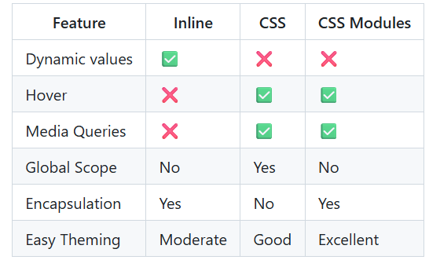
Comparing all 3 methods

Slide 20
Real World Example - Dashboard
Global CSS
body{
font-family:Inter;
}
CSS Modules
DashboardCard.module.css
Inline Styles
<div
style={{
width: progress + "%"
}}
>
The three approaches work together.

Slide 21
Best Practices
Prefer CSS Modules for reusable components.
Keep global CSS minimal.
Use inline styles only when values are computed.
/* Avoid */
style={{
padding:"20px",
margin:"20px",
border:"1px solid black",
...
}}
/* Large style objects reduce readability */

Slide 22
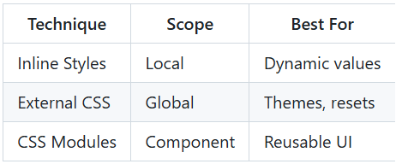
Summary

Slide 23
Key TakeAways
React does not replace CSS.
Instead, React offers multiple ways to connect components with styling.
The best React applications combine:
  Global CSS
  CSS Modules
  Inline styles
Each where it makes architectural sense.

